Slide 1


IoT Security Networking
A simple IoT Security project on secure and not secure communication tasks.

Slide 2







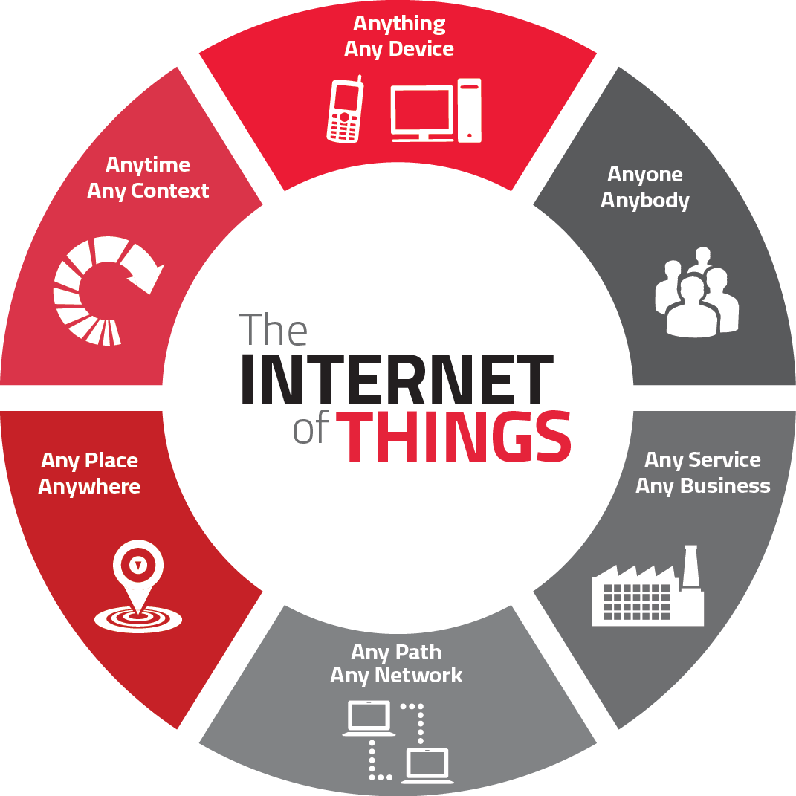





Project Idea
In recent years, there has been an exponential growth of IoT devices in critical sectors such as healthcare, industry and home automation.
Thus, there is an emerging need to ensure secure and protected.
Securing data transmissions is critical to prevent unauthorized access, safeguard privacy, and ensure the integrity of IoT systems.

Slide 3



Project Idea
Client – requesting secure (HTTPS) or non-secure (HTTP) communication and sending a secret (shared with the server).
Server – establishment of communication with the client, security check (HTTPS) and secrecy check. It responds with the requested service by sending an appropriate HTTP Response.
It is intended to demonstrate that a client-server communication system, properly implemented with advanced security mechanisms, can provide resilience against common attacks on IoT devices, such as the replay attack.

Slide 4



Technologies
The ESP-IDF and Arduino are frameworks used to develop innovative IoT applications, combining the flexibility of programming with Arduino and the power of the native development environment for ESP32.

Slide 5



Technologies
Flipper Zero
Marauder Framework
Wireshark
https://docs.flipper.net/
https://github.com/justcallmekoko/ESP32Marauder
https://www.wireshark.org/

Slide 6

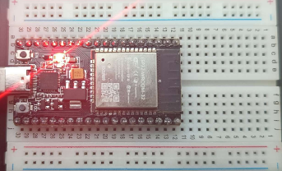
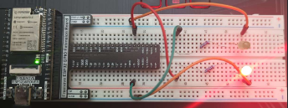
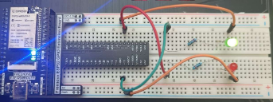
Show Case
Client
Server Fail
Server Success

Slide 7
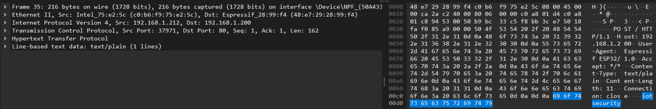
Show Case
TCP HTTP – Clean text/plain Handshake.
TCP Packet Details (secret key bytes are clearly visible).

Slide 8
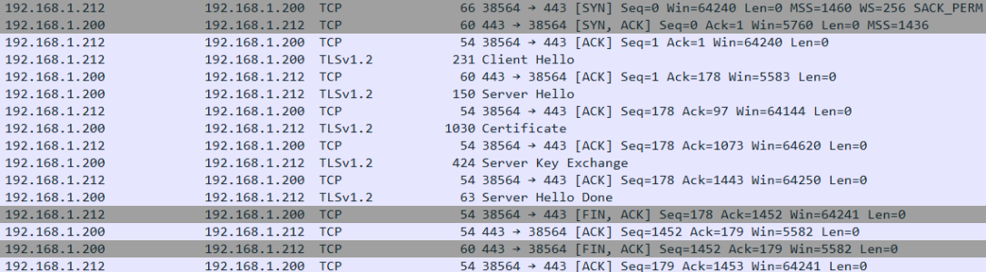
Show Case
TCP HTTPS – Three-Way-Handshake (Secure).

Slide 9

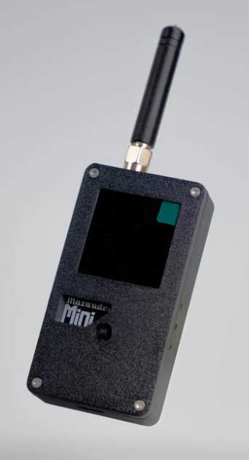
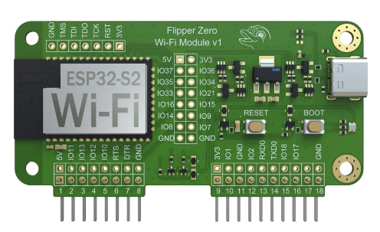
Firmware Marauder (test 1)
An eavesdropping test with the Marauder involves intercepting Wi-Fi traffic in an unprotected or vulnerable network. Here is a summary of the process:
The “ESP 32 Mini” or “Flipper Zero” tool with WiFi extension was used to sniff, in promiscuous mode, the packets.
The intercepted packets were saved in .pcap format.
PCAP files were moved to a pc and analyzed with wireshark.
The “vulnerable” packets were copied to special files and replicated later.

Slide 10
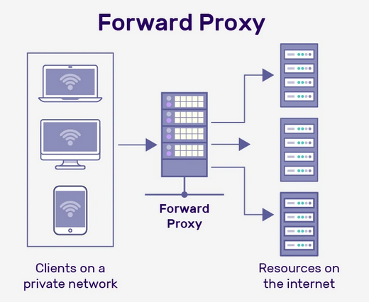
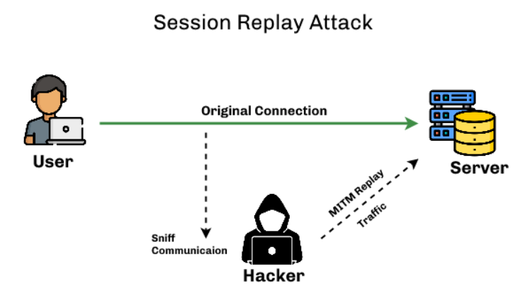
Proxy Server (test 2)
A second test was done with a supporting “ESP 32” going into “Man in the Middle” mode as a Proxy Server.
The simulation considers an “Evil” or “Good” Proxy Server scenario.
A proxy server intercepts incoming traffic and forwards it, providing an unencrypted view of the traffic. This can lead to eavesdropping and the exposure of sensitive data exchanged between the client and server, thus requiring increased attention and reliability in IoT communication systems.

Slide 11
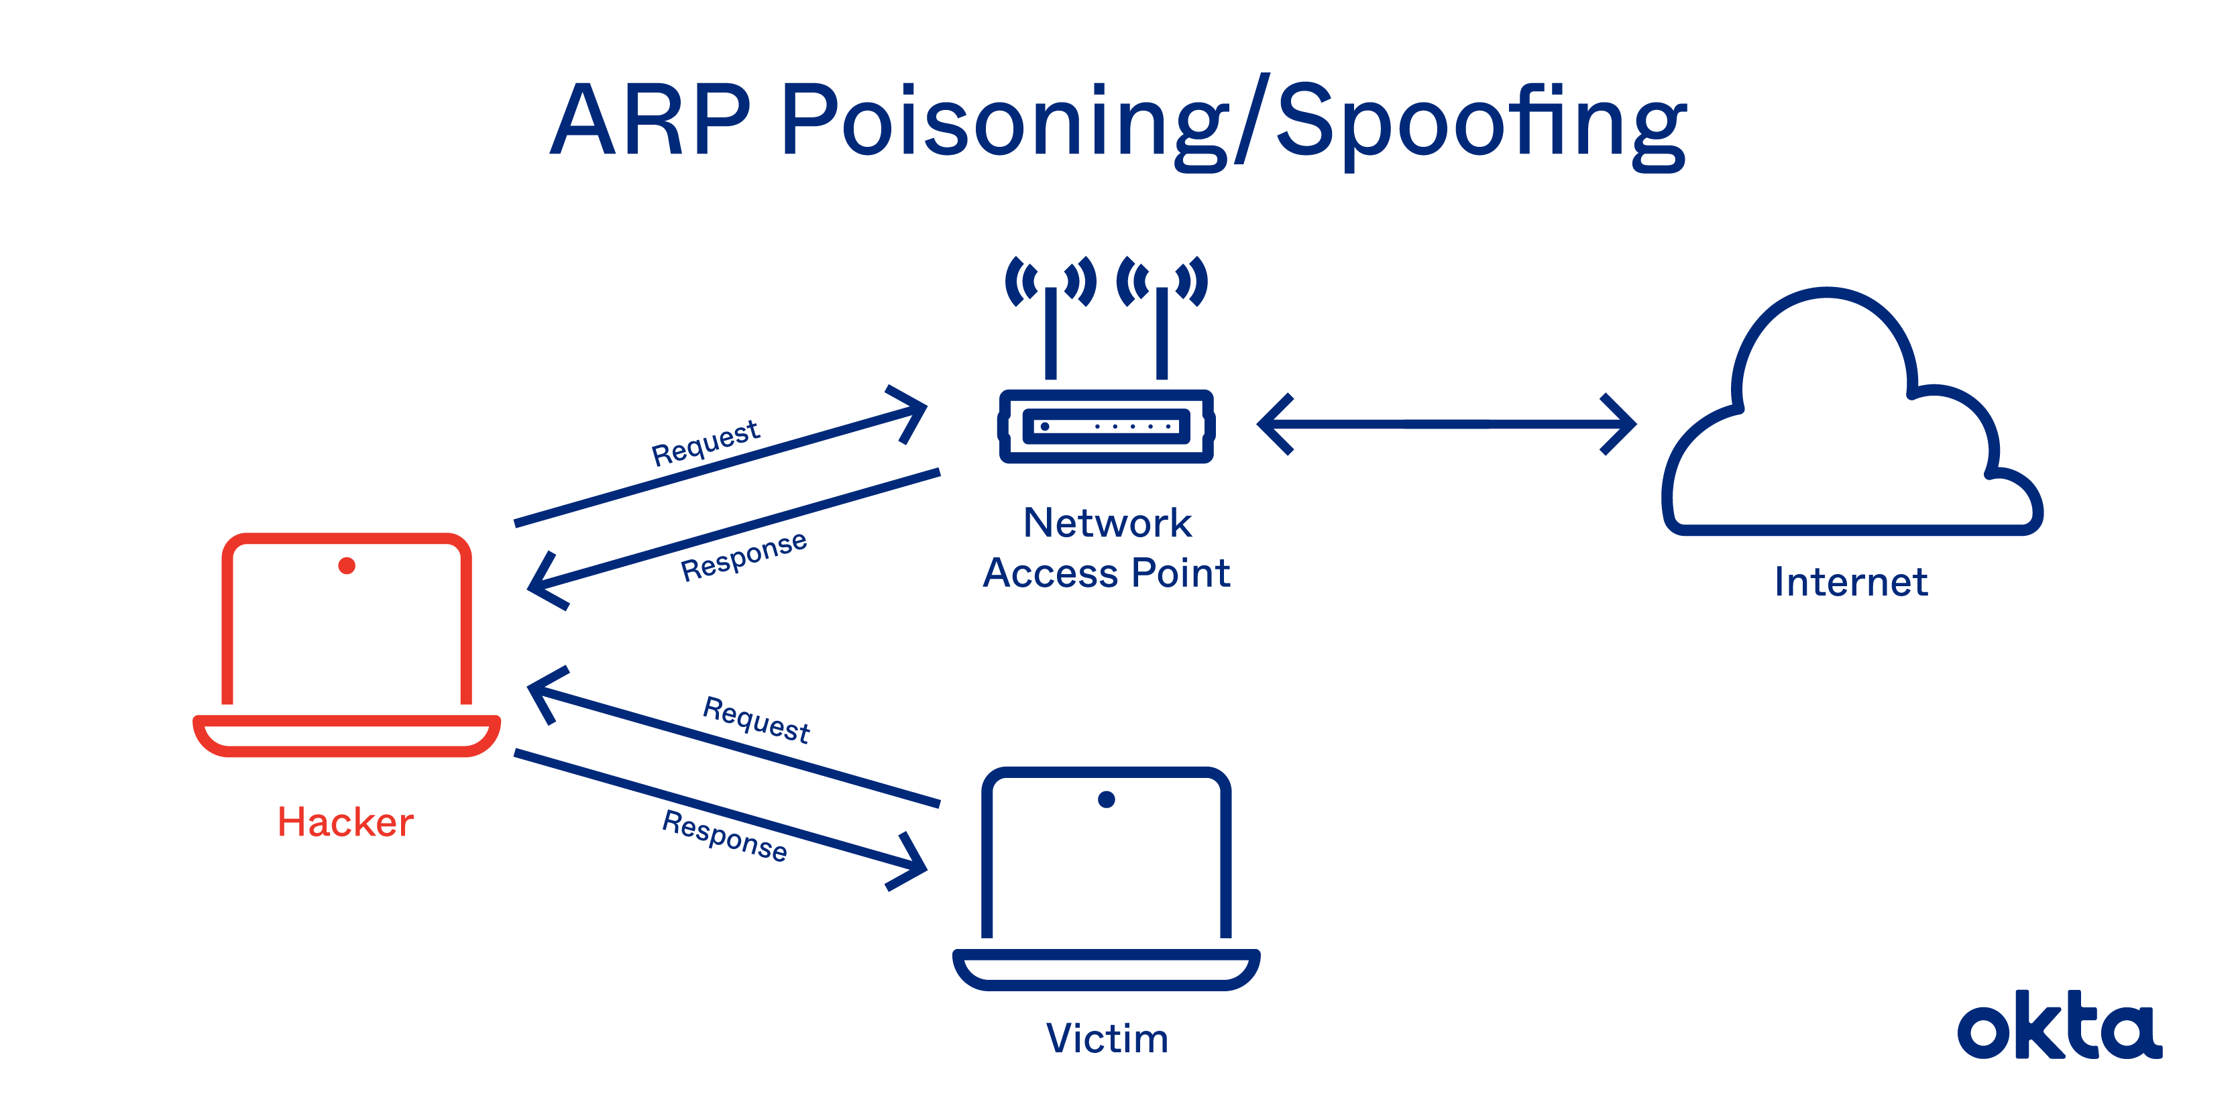
Network Redirect (test 3)
A machine was used to carry out an ARP Spoofing attack.
The machine sent spoofed ARP packets in order to pretend to be the target device (the server).
Although the attack is successful, particularly with efficiency in unsecured HTTP communications, the Three-Way-Handshake is not feasible, since the client cannot be authenticated, given the absence of the server certificate by the attacking machine.

Slide 12


Future Devs
- Integration of Additional Security Protocols:
Advanced TLS, DTLS, MQTT protocol, and lightweight on-board encryption.
- Automation of Traffic Analysis:
Automatic Traffic Analysis (ATA) scripts and automated analysis tools.
- Implementation of Intrusion Detection Techniques:
Intrusion Detection System (IDS) based on lightweight machine learning (Tensorflow Lite) on-board.
- Optimization of Energy Consumption:
Improvement of dynamic allocation techniques and distribution of energy consumption, addition of independent energy support.

Slide 13


End of the presentation
Antonio Garofalo
Full stack Developer
GitHub
Fulvio Serao
Full stack Developer
GitHub
«Thank you»

